Slide 1
Fandango
By
Cole Mausteller

Slide 2

What is Fandango?
A movie ticketing service
Theater Locator
Movie News
Streaming Service (Vudu)
Purchased by Comcast for 200 million

Slide 3
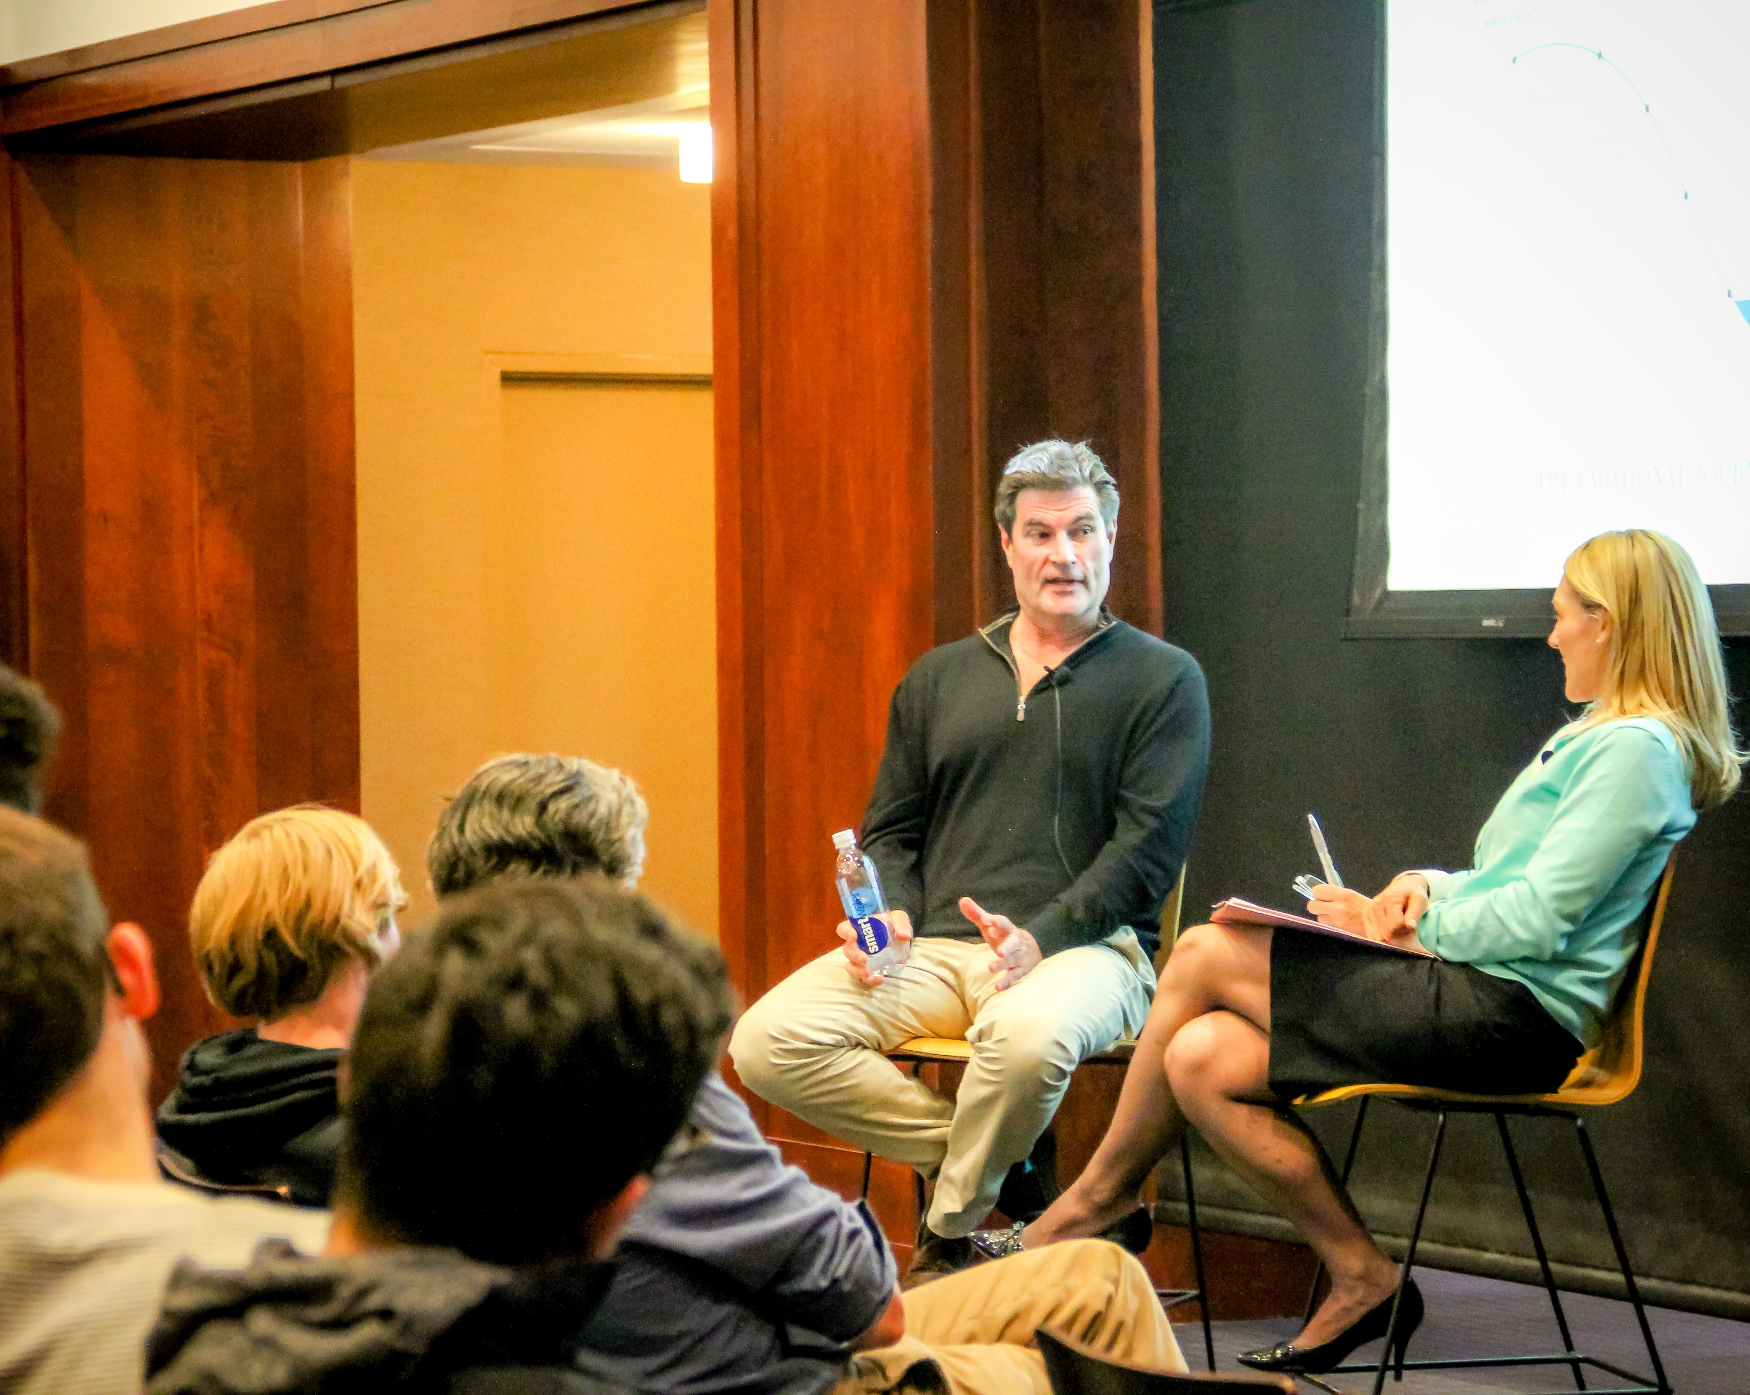
J Michael Cline
Founded/Co-Founded
Accumen Inc - Leading outsourcer of laboratory operations for large hospitals.
Accolade, Inc. - The leading vendor of population health services for large employers.
Accretive Health, Inc - The leading vendor outsourcing the revenue cycle for large hospitals.
Panthera Poacher Cam - Originally designed for the Panthera Tigers Forever Initiative, is now used in a number of wildlife areas.

Slide 4
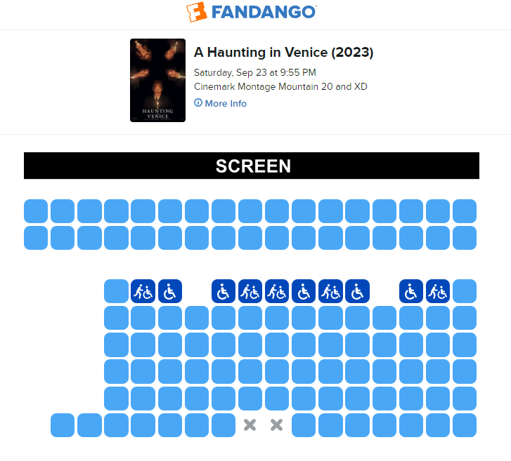
Why use Fandango?
No waiting in line
Early bird ticketing
Seat Selection (if available)
Both Fandango and Vudu are free to use
Rewards points

Slide 5

Fan rewards
500 rewards points = $5 coupon
125 point per ticket
Point promotions
Full refunds
Double dip

Slide 6
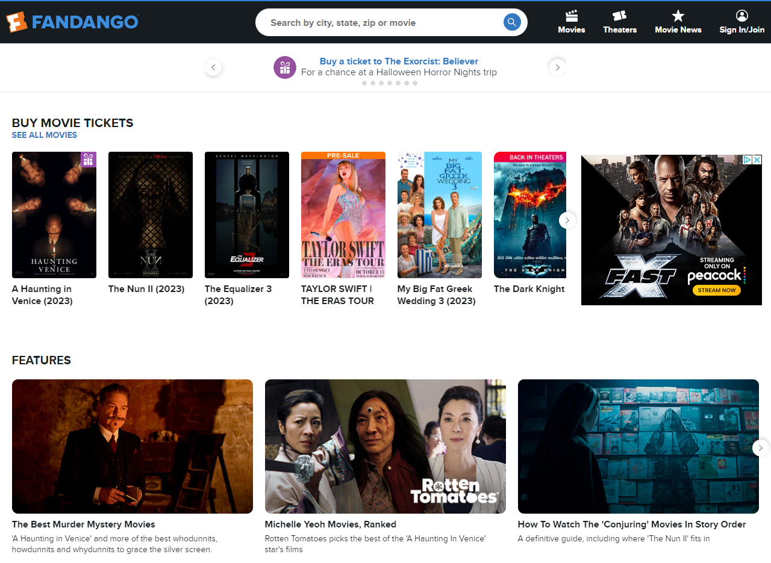
Web Traffic
Global rank = 1182
Country rank = 363
Category rank = 15
Total visits last month = 24.7 million

Slide 7
Review Questions
What is the last name of the founder of Fandango?
  Hunt
  Smith
  Cline
  Ishman
Answer - C

Slide 8
Review Questions
What is Fandango?
  Movie ticketing site
  Streaming service
  Fan shop
  Movie critique website
Answer - A

Slide 9
Review Questions
Who is the majority shareholder of Fandango?
  Pixar
  Comcast
  Disney
  HBO
Answer - B

Slide 10
Review Questions
Where does Fandango rank on sites searched in the Arts & Entertainment category?
  1st
  7th
  15th
  23rd
Answer - C

Slide 11
Review Questions
What is Fandango's streaming service called?
  Netflix
  Hulu
  Roku
  Vudu
Answer - D

